Slide 1

Natural Language Processing
CS 563
Automated News Summarizer for Mahakumbh
Group - 23
Sreya Gunda (2101AI15)
Ishani Sharma (2101AI16)
Mamta Kanwar (2101CS42)

Slide 2

Problem Statement
Context | Mahakumbh generates extensive media coverage.
Challenge | Manual tracking of news is overwhelming.
Goal | Build an automated system to summarize news articles.
To automatically generate concise and informative summaries of Indian news articles on Mahakumbh, using NLP techniques, enabling faster and easier understanding of key information.

Slide 3

Motivation
Difficulty in extracting key information quickly
Lack of automated tools tailored to Mahakumbh-specific content
Volume of daily news during Mahakumbh is overwhelming

Slide 4

Dataset Collection
Collect or generate a dataset of Indian news articles focused on Mahakumbh.
Project Workflow: Key Tasks
Dataset Annotation
Create ground truth summaries for each article.
Model Development
Build a system to summarize articles into concise, informative outputs.

Slide 5

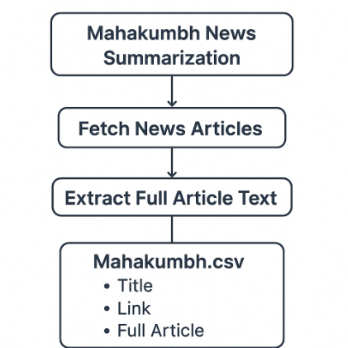

Task 1: Dataset Collection
To create a high-quality summarization dataset for news related to Mahakumbh, we implemented a
2-phase pipeline and collected 1050 News Articles from Google News Website.

Slide 6


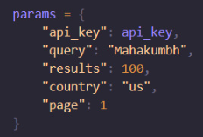
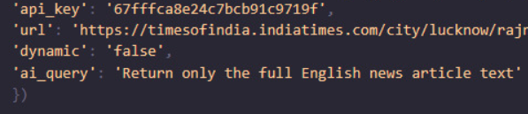

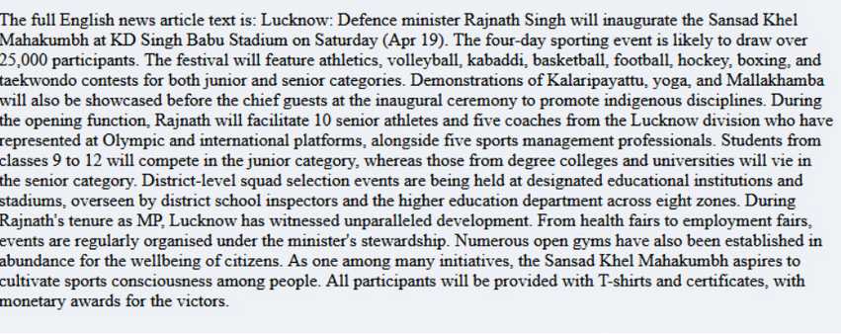
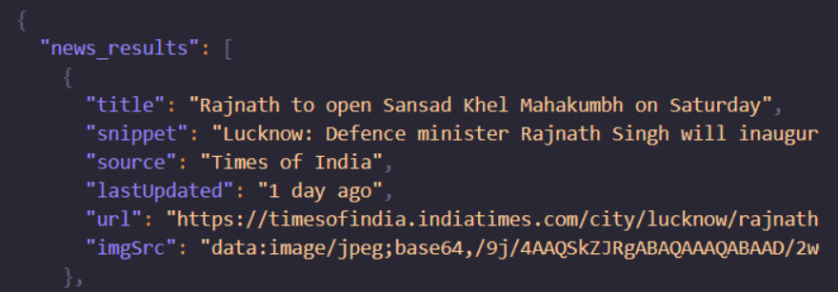
Task 1: Dataset Collection
Collect news headlines & links
Extract full article content
ScrapingDog Google News API
ScrapingDog General Scrapper with AI Prompt
URL
Final News Article

Slide 7


Task 2: Dataset Annotation
Create ground truths for each article that highlights the main points in the document.
Tool:
Abstractive Summarization
Google Gemini Pro
(via Python SDK)
Generates a summary using new words and sentences not found in the original text.
Goal: Add around 100-word summary per article
Prompt: “Summarize the following news article in 100 words or less”

Slide 8
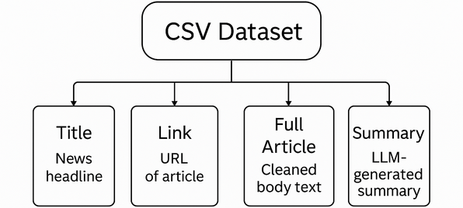
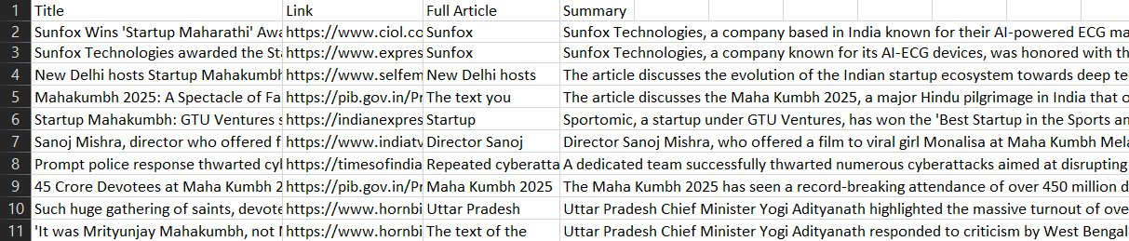
Final CSV Dataset Format
Dataset is now ready for NLP tasks like summarization, classification, fine-tuning.

Slide 9
Task 3: Model Development
Experimented and fine-tuned multiple transformer models for abstractive summarization of Mahakumbh religious news articles.
Key Steps:
Fine-tuning on our domain-specific data
Handling long-context news content
Generating high-quality summaries using multiple model architectures.
Evaluating using ROUGE, BLEU, BERTScore, and METEOR.

Slide 10
Models:
Model | Architecture | # Parameters | Summary Style | Strengths
BART | Encoder-Decoder Transformer | ~406M | Balanced | Combines denoising pretraining with generative decoding.
LED | Longformer Encoder-Decoder with Sparse Attention | ~418M | Detailed & coherent | Designed for long inputs; well-suited for lengthy religious and cultural articles.
Pegasus | Encoder-Decoder Transformer | ~568M | Concise & clean | Pretrained specifically for abstractive summarization.
FLAN-T5 | Encoder-Decoder, Instruction-Tuned | ~250M | Direct & Prompt-based | Performs well in zero-shot settings; follows prompts effectively.
Gemma-1B | Decoder-Only LLM | ~1.0B | Structured & Prompt-sensitive | Ideal for fast experimentation with prompt-tuned inputs.

Slide 11
Evaluation Metrics:
Metric | Evaluates
BLEU | Measures n-gram overlap
ROUGE | Measures recall of overlapping n-grams, word sequences, and word pairs
BERTScore | Asseses semantic similarity using embeddings
METEOR | Considers exact, stem, synonym, and paraphrase matches

Slide 12
Experimental results:
Model | BLEU | ROUGE-1 | ROUGE-2 | ROUGE-L | METEOR | BERTScore F1
BART | 0.3223 | 0.5783 | 0.3541 | 0.4497 | 0.4988 | 0.9180
LED | 0.3173 | 0.5698 | 0.3485 | 0.4466 | 0.5045 | 0.9189
Pegasus | 0.2331 | 0.5116 | 0.2876 | 0.3971 | 0.4125 | 0.9083
Gemma | 0.0545 | 0.2844 | 0.0944 | 0.1818 | 0.2701 | 0.8708
Flan-T5 | 0.0144 | 0.2293 | 0.1285 | 0.1850 | 0.1271 | 0.8655

Slide 13
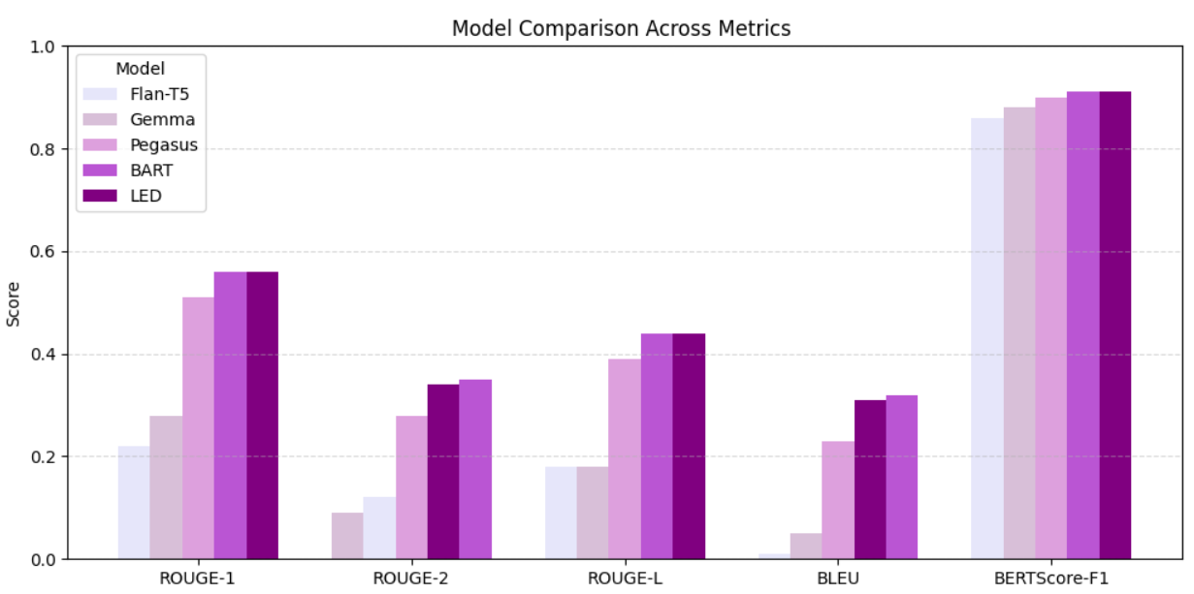
Model performance comparison across different evaluation metrics

Slide 14
Observations:
BART
Achieved the highest BLEU and ROUGE-2 scores, indicating strong n-gram precision and summary coherence. Best for structured, concise summaries.
LED
Scored highest in ROUGE-1 and BERTScore, making it ideal for semantic similarity and faithful long-form generation.
Pegasus
Balanced performance across metrics, especially strong in ROUGE-2, showing effectiveness in capturing domain nuances.
FLAN-T5
Performed the weakest across metrics except for BERTScore. Struggled with domain-specific depth, better suited for generic prompts.
Gemma-1B
Despite being the smallest, held up decently in ROUGE-1 and BERTScore, showing promise with prompt engineering in resource-constrained environments

Slide 15
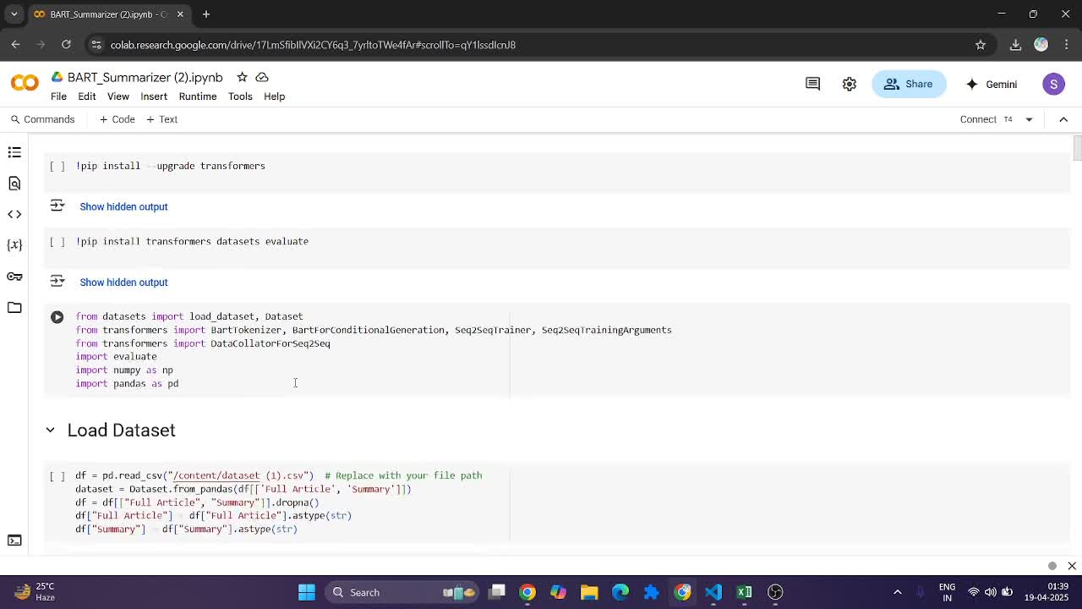
Demo
Demo Link

Slide 16

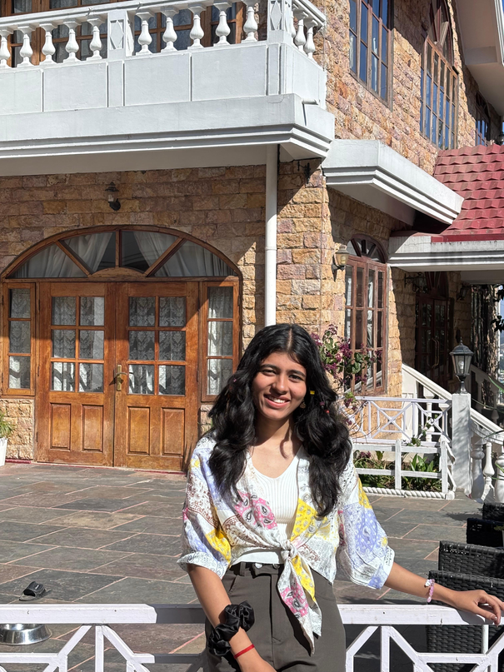

Contribution
Sreya Gunda (2101AI15)
Ishani Sharma (2101AI16)
Mamta Kanwar (2101CS42)
Collected ~350 news articles using scraping.
Annotated the entire dataset.
Finetuned and evaluated BART model for summarization.
Collected ~350 news articles using scraping.
Finetuned and evaluated LED model for summarization.
Finetuned and evaluated Gemma model.
Collected ~350 news articles using scraping.
Finetuned and evaluated Pegasus model.
Finetuned and evaluated FLAN-T5 Base model.

Slide 17
Thank You!!

